Slide 1

Predicting Academic Success: A foundational step towards personalized education
User Interface
Presenter: Samson Dawit Bekele
2nd Course, Department of Computer Science, FIT, Al-Farabi Kazakh National University
Advisor: Assoc. Prof., PhD, Imankulov Timur Sakenovich
Digital Farabi, March 2024

Slide 2
Academic Success Predictor - a critical first step towards personalized education
Recommending courses based on learning preference and academic performance is almost impossible as shown by previous studies.
This is because of the lack of appropriate datasets, however, we propose to predict academic success as it is a first critical step towards personalized education.
We have developed a user interface for our trained models, serving as a proof of concept to illustrate the potential applications in personalized education.

Slide 3


User Interface – Tech Stack
The user interface was made using a python framework called Streamlit.
It is a framework to build web applications for machine learning.
The UI built allows educators, administrators, and students predict academic outcomes based on academic, socio-economic, demographic, and social features.
There are a total of 4 models to make predictions of various academic outcomes
SQLite3 was used to store the datasets in different tables of a database.

Slide 4
The 4 academic success predictor models trained
Model 1
Model 2
Type: Logistic Regression Model
Objective: Predict graduation and dropout rates
Accuracy: 92%
Dataset: 4424 students and 36 features. Socio-economic, demographic, macro, and enrollment data, academic features.
Preprocessing: (3630x33)
Key Factors: Academic and socio-economic factors
Type: Support Vector Classifier Model
Objective: Predict pass or fail rate in a Math class
Accuracy: 91%
Dataset: From high school, Includes 32 features and 395 data points. Contains student grades, demographic, social and school-related features.
Key Factors: Academic performance (grades, study time), social behaviors (going out, travel), and other factors like health and parent's job.
Model 3
Model 4
Type: Support Vector Classifier Model
Objective: Predict pass or fail rate in a Portuguese language class
Accuracy: 95%
Dataset: From high school, includes student grades, demographic, social and school-related features. It has 32 features and 649 data points.
Insights: The model considers academic records, health status, family relations, free time and aspirations for higher education as key features.
Type: Stacking Classifier (Random Forest, Adaboost, Logistic regression (LR) as base learners and LR as final learner)
Objective: Predict pass or fail rate in an academic year
Accuracy: 83% (lower accuracy)
Dataset: From university, includes student grades, demographic, social and school-related features. It has 31 features and 145 data points.
Insights: Not possible from stacking but base learners considered: academic, social, and socio-economic features important

Slide 5
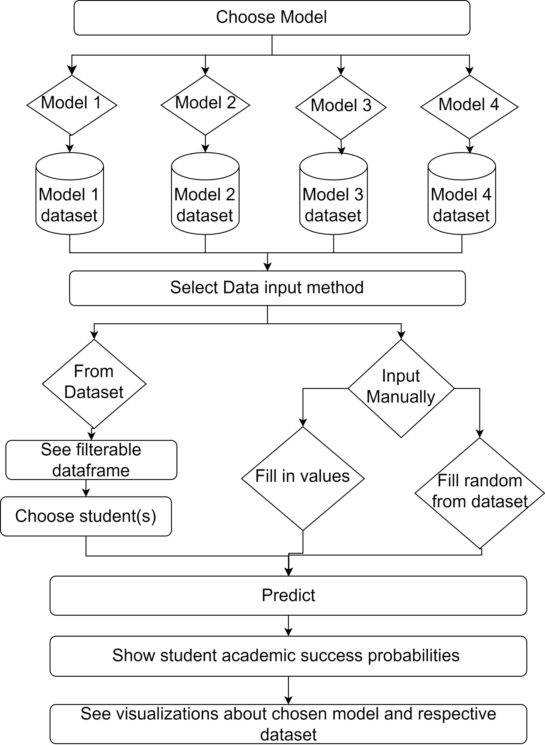
How it works

Slide 6
Implications and use cases
Customized learning paths
Data-driven decision making: resource allocation and curriculum development
Identify at-risk students
Addressing educational disparities
Informing policy development
Future Work and Considerations
Creating our own dataset by creating a comprehensive and ethical survey to integrate personalization variables, as done by Nabizadeh, S. et al¹.
Integrate to Univer system to develop a real-time recommendation system.
Collaborate with other universities for more a representative sampling.
Nabizadeh, S., Hajian, S., Sheikhan, Z., & Rafiei, F. (2019). Prediction of academic achievement based on learning strategies and outcome expectations among medical students. In BMC Medical Education (Vol. 19, Issue 1). Springer Science and Business Media LLC. https://doi.org/10.1186/s12909-019-1527-9

Slide 7

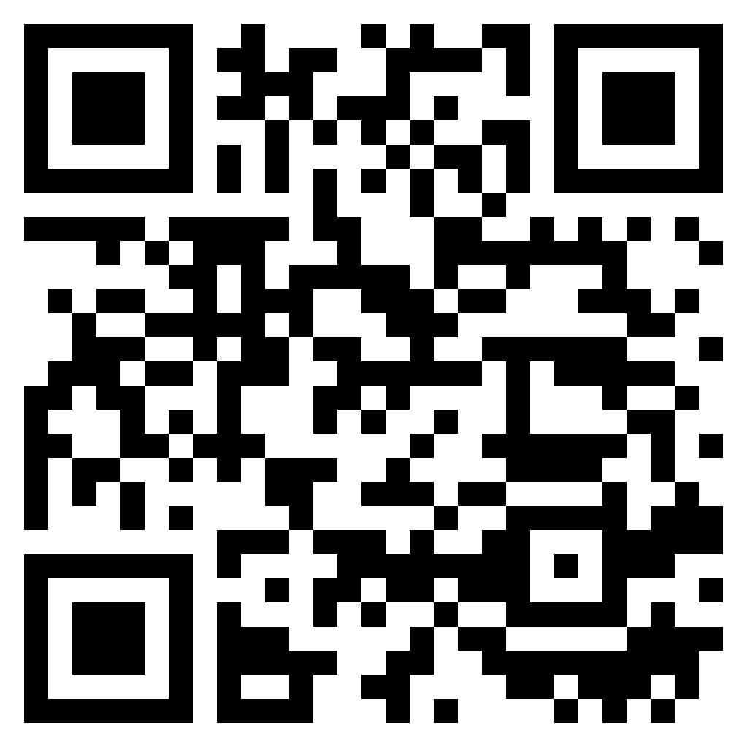

Demonstration
https://academic-success.streamlit.app/
https://gitlab.com/samsondawit/student-success

Slide 8
Thank you
Presenter: Samson Dawit Bekele
Advisor: Assoc. Prof., PhD, Imankulov Timur Sakenovich

